Slide 1
C++ Programming:
Problem Solving and Programming
Chapter 7
Pointers

Slide 2
Objective
Pointer variable
Pointer addresses
Pointer manipulations

Slide 3
Introduction
Every variable has a memory location in the memory. Every memory location has an address which is accessed by an ampersand (&)
Example:
int var1;
char var2;
cout << “Address of var1 : ” << &var1;
cout << “Address of var2 : ” << (void *)&var2;
Notes:
e.g. withdrawal, deposit, bank transfer, print statement, change withdrawal limit, change password, check deposit. Deposit can be further divided into deposit cash to own account or other account.

Slide 4
Pointer/Pointer Variable
A pointer is a variable whose value is the address of another variable (storing the address of the variable that the pointer is pointing to).
P (pointer P stores address only)
BC231
variable A
10FFA
10FFA
300

Slide 5
Pointer Declaration
Must have an asterisk before each of the pointer variables.
type *pointer variable name;
Example:
  int *ip; // pointer to an integer var.
  double *dp; // pointer to a double var.
  char *ch; // pointer to character
Pointer variable can only point to the variable of the same type.

Slide 6
Pointer Declaration
The asterisk * can appear anywhere between the type and variable name
Example:
  int *p;
  int* p;
  int * p;
  int *p, q; (p is pointer variable, not q)
  int *p, *q; (both p and q are pointer variables)

Slide 7
Assign Value to Pointer
The pointer declaration allocates memory space for the pointer variable, but does not make it point to anything. E.g. int *ptr;
To make a pointer point to something, the address operator (&) is used. This assigns address value to the pointer variable.
E.g.: int *ptr, x = 10 ;
ptr = &x ; //assign the address of x to ptr
// or pointer ptr points to x
QR294 26TSE
ptr
26TSE
75
x

Slide 8
Assign Value to Pointer
double *number; not equal to *number
double a =10;
double *number = &a; // 1 line, is the same as
double *number;
number = &a;
** But not *number = &a;
Declare a double type pointer
Reference to variable
// 2 lines
X

Slide 9
Dereferencing Operator (*)
When used as a unary operator, *
  Called dereferencing operator or indirection operator
  Refers to object or variable to which its pointer is pointing to
  Returns the value stored in the variable or stores a value into the variable through the pointer variable
  E.g. int num = 10, *ptr = &num;
    cout << *ptr; // return 10 as output
    *ptr = 20; // store 20 into num through *ptr

Slide 10
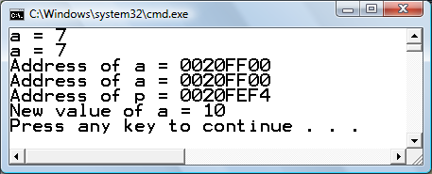
Dereferencing Operator (*)
//Program illustrates the distinction between a pointer
//value and its dereferenced value
int main( ) {
int a=7, *p=&a;
cout << "a = “ << a <<endl;
cout << "a = “ << *p <<endl;
cout << "Address of a = "<< &a <<endl;
cout << "Address of a = "<< p <<endl;
cout << "Address of p = "<< &p <<endl;
*p=10;
cout<<"New value of a = "<< a <<endl;
return 0;
}

Slide 11
Initializing Pointer Variable
C++ does not automatically initialize variables
Pointer variables do not point to any valid object, it can be initialized using the constant value 0, called the null pointer
The following two statements are equivalent:
p = NULL; // predefined constant
p = 0;

Slide 12
Pointer - Example
#include <iostream>
using namespace std;
int main ( ) {
  int value1 = 5, value2 = 15;
  int *mypointer = NULL;
  mypointer = &value1;
  *mypointer = 10;
  mypointer = &value2;
  *mypointer = 20;
  cout<<value1<<"/"<<value2;
  return 0;
}
Output：
10/20

Slide 13
Pointer - Example
#include <iostream>
using namespace std;
int main ( ) {
int value1 = 5, value2 = 15， *p1, *p2;
p1 = &value1;
p2 = &value2;
*p1 = 10;
*p2 = *p1; // assign value
p1 = p2; // assign address
*p1 = 20;
cout<<value1<<"/"<<value2<<endl;
return 0; }
Output：
10/20

Slide 14
Dynamic Variables using new
Variables can be manipulated even if the variables have no identifiers to name them.
The operator new can be used to create variables that have no identifiers to serve as their names. These nameless variables are referred to via pointers.
Example:
int *p;
p = new int; // p points to nameless var.

Slide 15
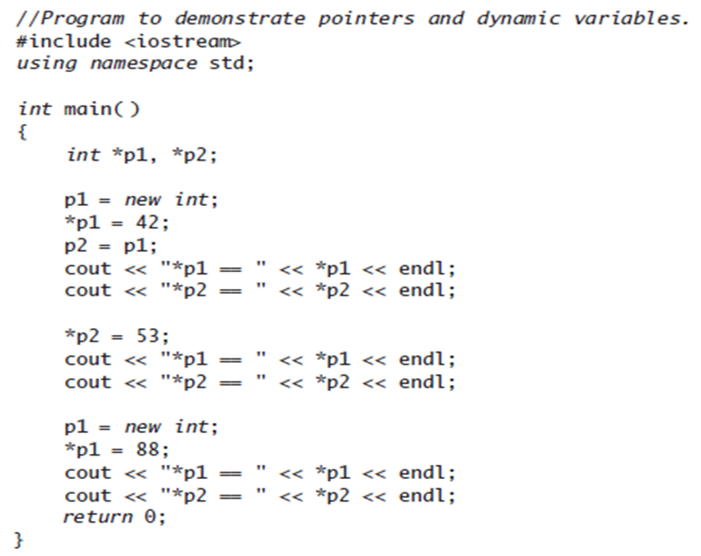
Dynamic Variables using new
Output:
*p1 == 42
*p2 == 42
*p1 == 53
*p2 == 53
*p1 == 88
*p2 == 53

Slide 16
Pointer Arithmetic
You can perform arithmetic operations on a pointer just as you can do on a numeric value, such as using:
    Increment (++) operator
    Decrement (--) operator
    Assignment (=) operator
    Addition (+) operator
    Subtraction (-) operator

Slide 17
Pointer Arithmetic
Each time a pointer is incremented by 1, it points to the memory location of the next element of its base type.
If “p” is a character pointer then “p++” will increment “p” by 1 byte.
If “p” in an integer pointer then “p++” will increment “p” by 4 bytes.

Slide 18
Pointer Arithmetic
Suppose we have:
char *mychar; //address 1000
short *myshort; //address 2000
long *mylong; //address 3000
If we write: ++mychar;
++myshort;
++mylong;

Slide 19
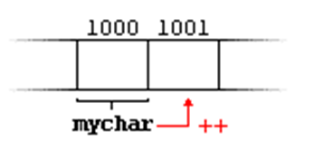
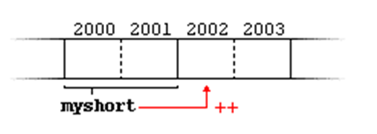
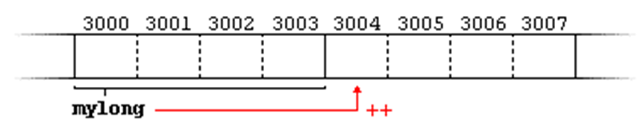
Pointer Arithmetic
++mychar;
++myshort;
++mylong;

Slide 20
Pointer Arithmetic - Example
#include <iostream>
using namespace std;
int main() {
int num = 7;
int *pnPtr = &num;
cout << pnPtr << endl;
cout << pnPtr+1 << endl;
cout << pnPtr+2 << endl;
cout << pnPtr+3 << endl;
return 0;
}

Slide 21
Pointer Arithmetic - Example
int main() {
int *x, *p, *q, c = 100, a;
x = &c;
p = x + 2;
q = x - 2;
a = p - q;
cout << "The address of x : " << x << endl;
cout << "The address of p after incrementing x by 2 : " << p << endl;
cout << "The address of p after decrementing x by 2 : " << q << endl;
cout << "The number of elements between p and q : " << a << endl; return 0; }

Slide 22
The use of dereference pointer (*)
Four possible combinations:
  *p++ // same as *(p++)
      increment pointer, and dereference unincremented (postfix) address
  *++p // same as *(++p)
      increment pointer, and dereference incremented (prefix) address
  ++*p // same as ++(*p)
      dereference pointer, and increment the value it points to
  (*p)++
      dereference pointer, and post-increment the value it points to

Slide 23
Reference Variable
A reference variable (or reference) is an alias, or an alternate name to an existing variable.
A reference is similar to a pointer.
To declare a reference variable, & is used in the declaration.
Syntax:
type &newName = existingName;
It shall be read as "newName is a reference to existingName", or "newName is an alias of existingName".

Slide 24
Reference Variable - Example
#include <iostream>
using namespace std;
int main()
{ int number = 88;
int & refNumber = number;
cout << number << endl;
cout << refNumber << endl;
refNumber = 99;
cout << refNumber << endl;
cout << number << endl;
number = 55;
cout << number << endl;
cout << refNumber << endl;
return 0; }

